Slide 1



FlipFit
=

Slide 2
The Ask - Where we started
When we embarked on this journey as beginners, through teamwork and guidance, we not only developed this app but also gained invaluable learning experiences along the way.

Slide 3

Framework for 6 days
6 days plan
Day 1: Introduction to UML Artifacts
Day 2: Introduction to Git and GitHub
Day 3: Classes vs Interfaces & Input/Output in Java
Day 4: Database Schema Design & DAO Layer Implementation
Day 5: JDBC (Java Database Connectivity) & Exception Handling
Day 6: Dropwizard Framework

Slide 4
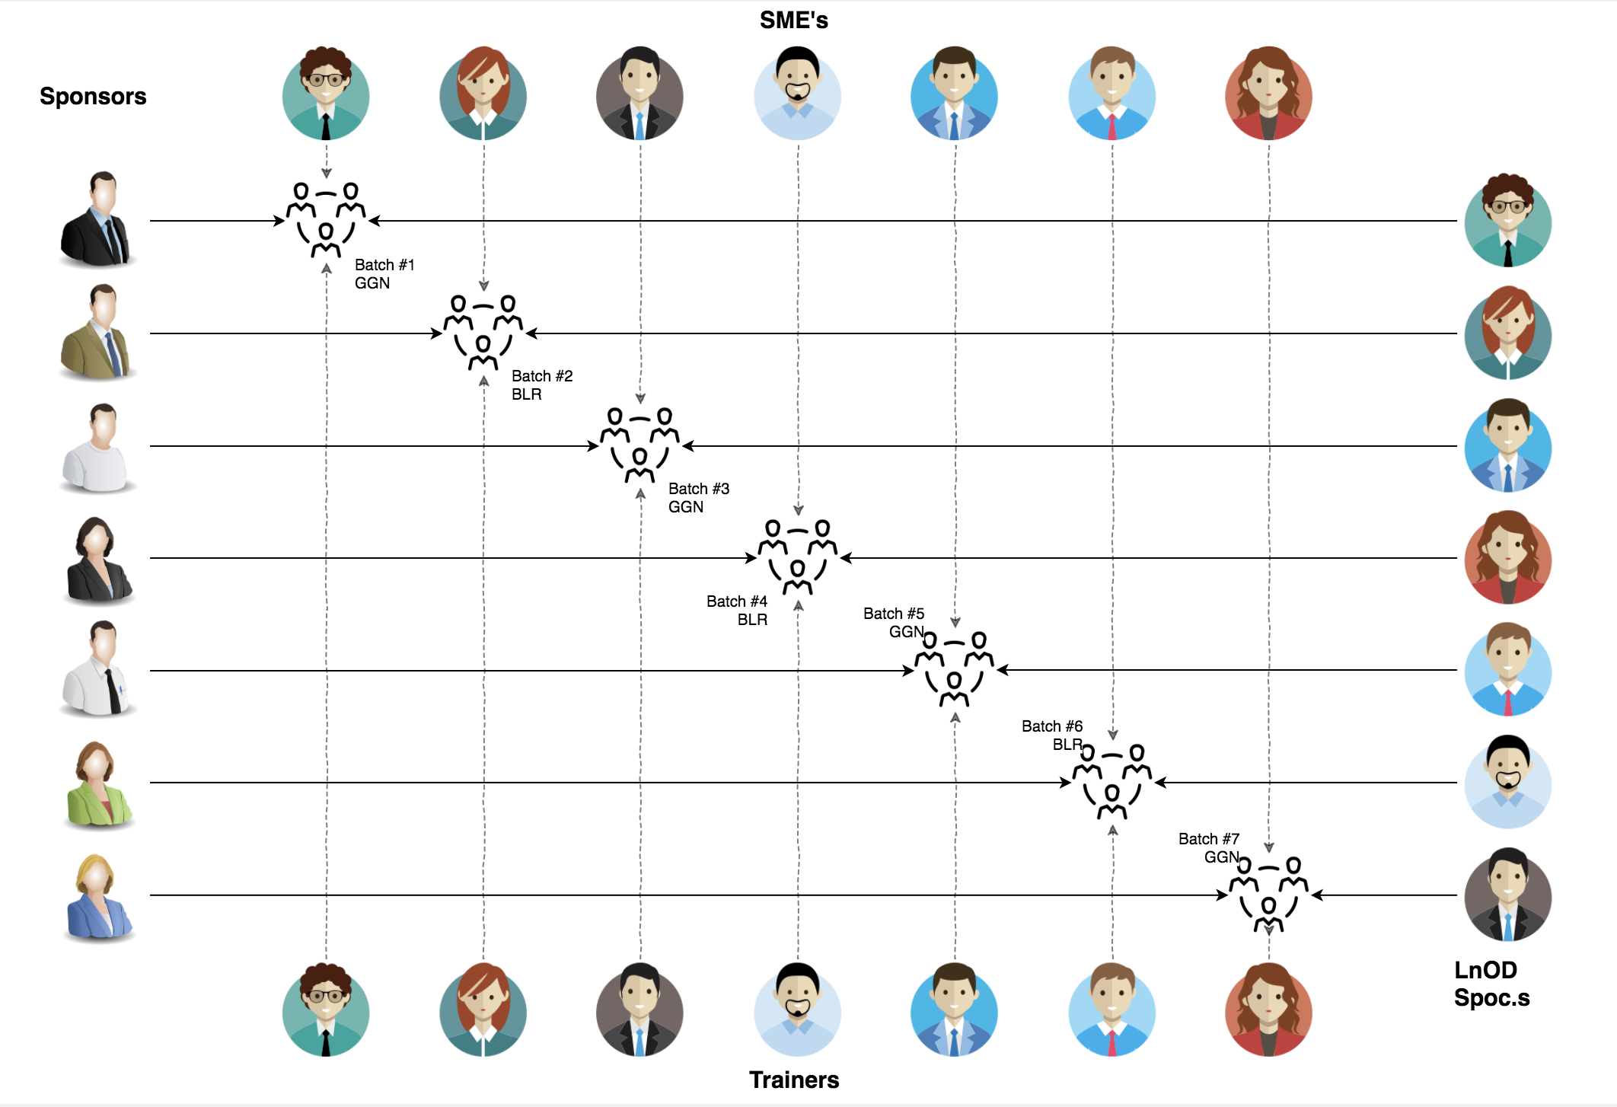
Stakeholders
1. Sponsor
- Flipkart
2. SME’s
- Amit Balyan
3. Co-ordinators
-Anushka khanna
-Sharath ramesha

Slide 5
Our next starts
NOW
Notes:
Time – 1 min
Swati

Slide 6
6 DAYS OF TRAINING + PROJECT DEMO
6 DAYS
144 HOURS
8640 MINUTES
518400 SECONDS
LIMITLESS KNOWLEDGE

Slide 7
Agenda
01
Our Journey
02
Our Team
03
Team Structure
04
Project Goals
05
Engineering Practices
06
Tech Stack
07
Development
08
Challenges & Learnings
09
Demo
10
Questions
Notes:
Time – 1 min

Slide 8

Our Journey
Notes:
Time - 2 mins

Slide 9
Demo
Process
Design
5
Project Demo
Tools
4
Implementing Core Functionality
Perceive
3
Designing the System Architecture and Database
2
Decide the Technologies and Tools - JAVA , Dropwizard , postman
1
Understanding Project Goals and Requirements

Slide 10

Our Team
Notes:
Time – 2 mins

Slide 11

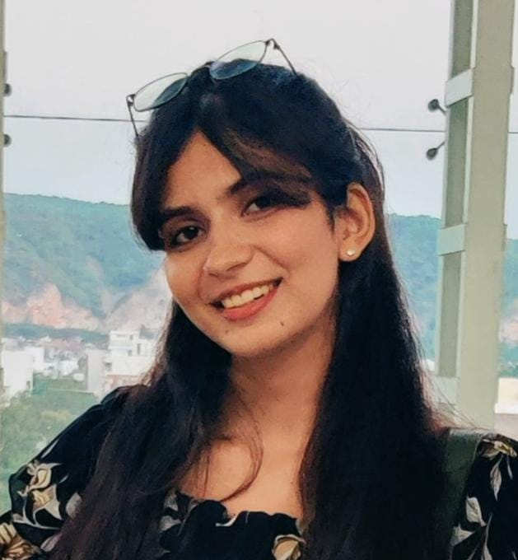
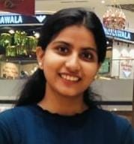
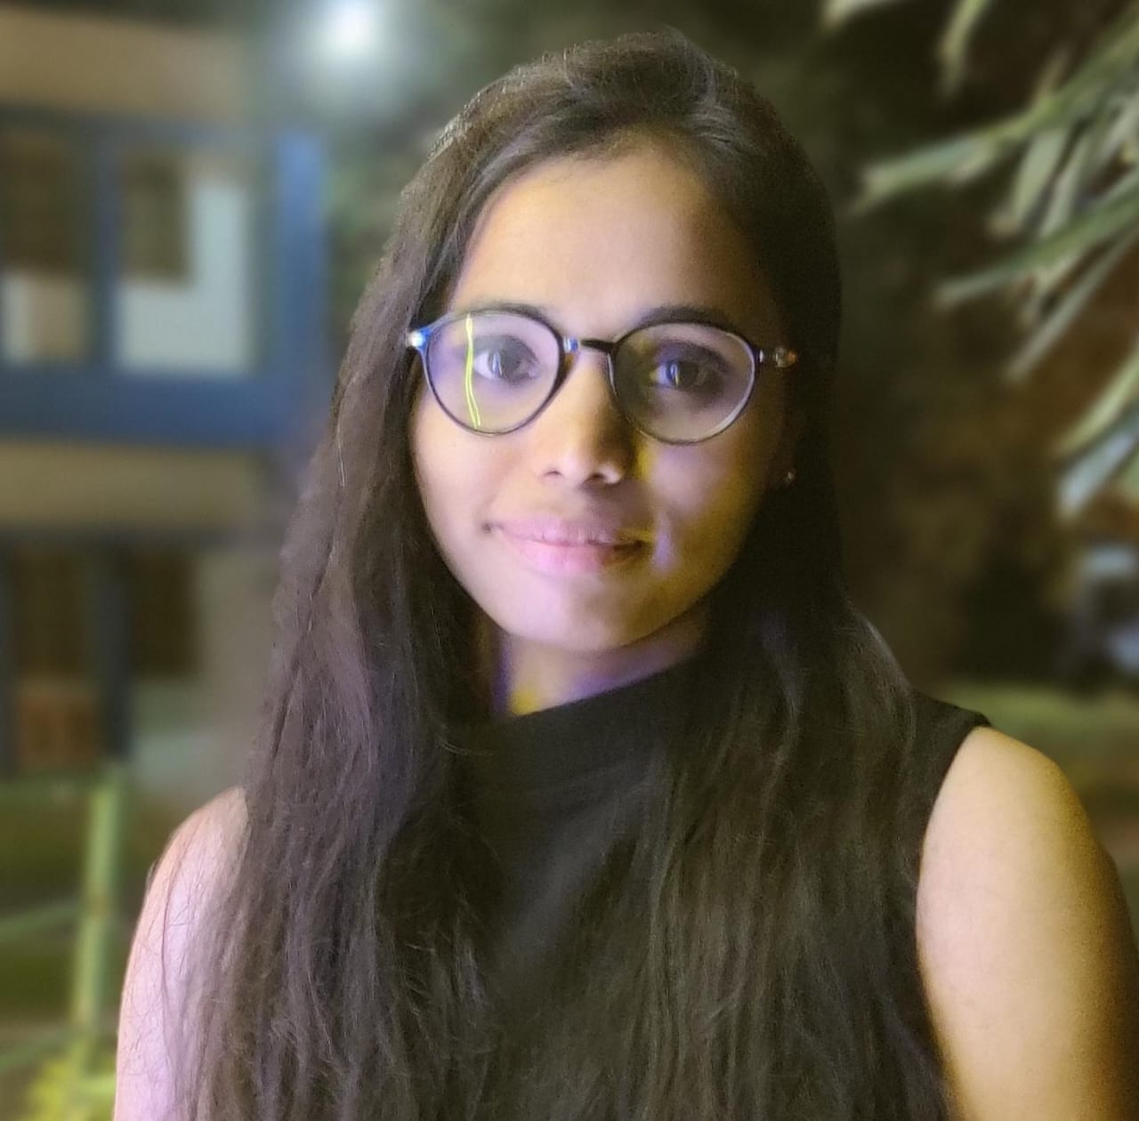
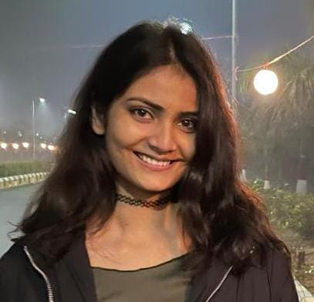
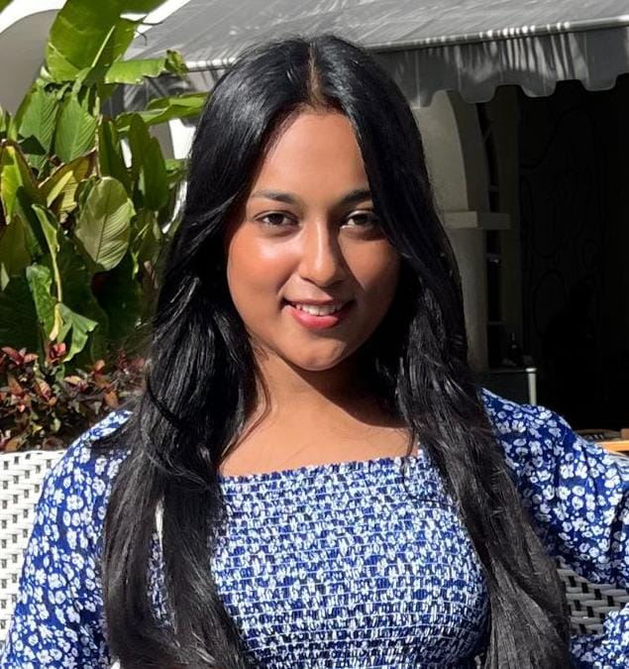
Nehal Chaturvedi
Group leader
Khushi Tiwari
Aqsa Ansari
S.Akshaya
Tanya Kumari
Tanya Sinha

Slide 12

Project Goals
Notes:
Time – 3 mins

Slide 13




Our Vision
The objective is to design and implement a FlipFit Gym application using Java Tools , that empowers users to register, check slot availability, and book workout sessions at various gym centers in Bangalore.
1
2
Quality
Security
3
4
Interactivity
Speed
Notes:
User satisfaction and brand value

Slide 14
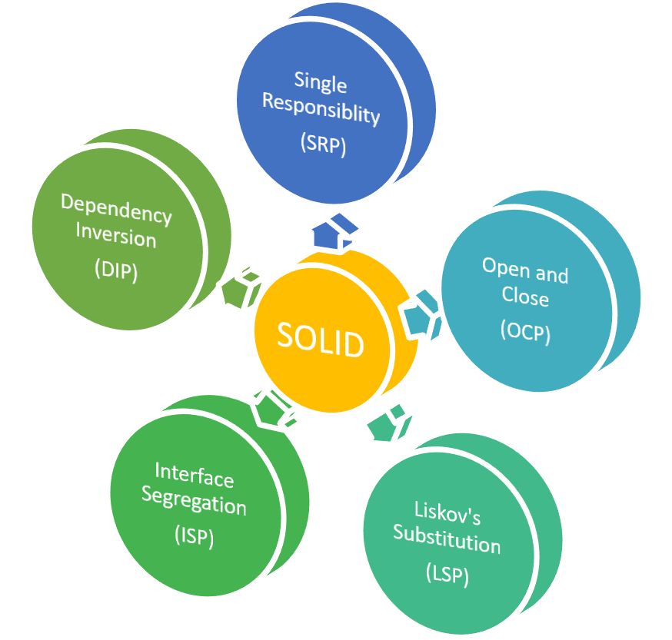
Engineering Practices
Our project adheres to the SOLID principles of object-oriented design in Java:
S - Single Responsibility Principle (SRP)
O - Open/Closed Principle (OCP)
L - Liskov Substitution Principle (LSP)
I - Interface Segregation Principle (ISP)
D - Dependency Inversion Principle (DIP)
Notes:
Time – 5 mins

Slide 15
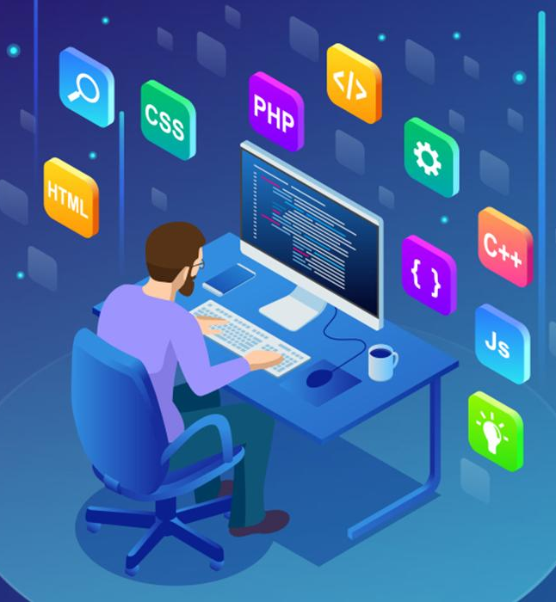
Tech Stack
Notes:
Time – 2 mins

Slide 16







Backend
Data
Tools
Core Language
SQL Database
IDE
SCM
Framework
API Testing
SCM
Notes:
Time – 1 min

Slide 17

Development
Notes:
Time – 1 min

Slide 18
Define Scope and Objectives
Break Down Features into Tasks
Allocate Resources and Assign Tasks
Set Milestones and Deadlines
Requirement understanding
Research and analysis
Estimation
Identify Dependencies and Risks
Sprint Planning
Spring Grooming
Delivery
Sprint Implementation
LLD
Development
Code Review
Commit
Integrate
Deploy
Test
Notes:
Time – 1 min

Slide 19

Challenges & Learnings
Notes:
Time – 2 mins

Slide 20
CHALLENGES
JDBC Connection: Faced problem in consistent connectivity across environments and managing JDBC driver compatibility with various databases.
SQL Workbench Setup and Schema Creation: Overcoming initial setup challenges and mastering SQL schema design and management for data integrity.
DAO Functions and Business Logic: In Implementing efficient operations and writing business logic to maintain data consistency.
Dropwizard Integration: Problem in Learning framework components and integrating it with the project.
Notes:
Time – 2 mins

Slide 21
LEARNINGS
Tech Stack Proficiency: Mastered Git, Java, MySQL, DropWizard, and Postman for robust application development.
Industry Best Practices: Adopted Agile methodologies and rigorous code reviews for efficient project management.
Effective Troubleshooting: Developed strong problem-solving skills by debugging and adopting systematic approaches.
Team Collaboration: Fostered a collaborative environment through regular communication.
Handling Challenges: Embraced ongoing learning to adapt to new challenges and technologies effectively.
Notes:
Time – 2 mins

Slide 22

Demo
Notes:
Time –
Architecture – 5 mins
NFR Dashboard – 3 mins
Demo – 10 mins
1. Show the Responsiveness and Wave tool first

Slide 23

Questions
Notes:
Time - ?

Slide 24
Thank you
Notes:
Time – After this show the testimonial video. 1 min

